Slide 1
RPA
Robotic Process Automation using UiPath

Slide 2
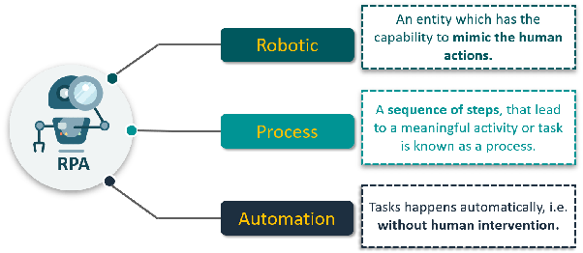
What is RPA?
RPA is a solution for Repetitive Business Tasks where work with Data Analysis, Fetching the data from various applications, filling the forms etc..
Its a tool based, repetitive task, reduces the human power and, scalability. It contains less code like .net, scripting language.

Slide 3
Why RPA?
In IT environment, not all the business processes are smart and intelligent. Many of them are dependent on multiple IT systems and not always talk to each other. Such mundane and repetitive tasks are time consuming and labor intensive for human beings. With the current automation methods, it takes massive IT transformation plans and implementation processes to make a transition to it. Here comes the relevance of Robotic Process Automation (RPA). RPA holds the power to automate almost all the repetitive, mundane and rule based tasks more quickly accurately and tirelessly, compared to a human being. It uses a machine (robot) that possesses tangible integration and automation capabilities which can mimic human interactions with web applications, web sites, portals, Excel worksheets, legacy green-screen apps, and email and helps automate the tasks. RPA is economically efficient than any other automation solutions that exist currently. Implementing RPA for redundant business processes also enables human beings to shift their focus from repetitive tasks to tasks requiring emotional intelligence, reasoning, judgement and interactions with the customers.

Slide 4
Benefits of RPA?
RPA automates repetitive tasks and enables improved business efficiency, data security and more effectiveness without altering the existing infrastructure and systems in an organization.
• Increased productivity and efficiency • Faster and easier implementation • Accuracy • Flexibility and scalability • Improved regulatory compliance • Cost savings

Slide 5
Applications of RPA?
• Financial Services: RPA can be used in financial services sector for automating the tasks including account closure and opening, managing audit requests, foreign exchange payments and insurance claims processing.
• Accounting: RPA can be used in operational accounting, general accounting, transactional reporting, planning and budgeting.
• Human Resource Administration: RPA can automate HR tasks in organizations including onboarding and off boarding tasks, time sheet submission processes, updating and amending employee details and so on.
• Healthcare: There are many areas in healthcare sector which RPA can play a significant role. This includes patient care record handling, claims, underwriter, account management, customer support, billing, reporting and analytics.
• Supply chain management: RPA in supply chain management involves automation of order processing and payments, procurement, monitoring inventory levels, and tracking shipments to ensure on-time delivery of materials.
• Customer Service: RPA can play a key role in redefining the customer service experience by automating the contact center tasks including uploading the scanned documents, verifying e-signatures, verification for automatic approval or rejection recommendations and so on.

Slide 6
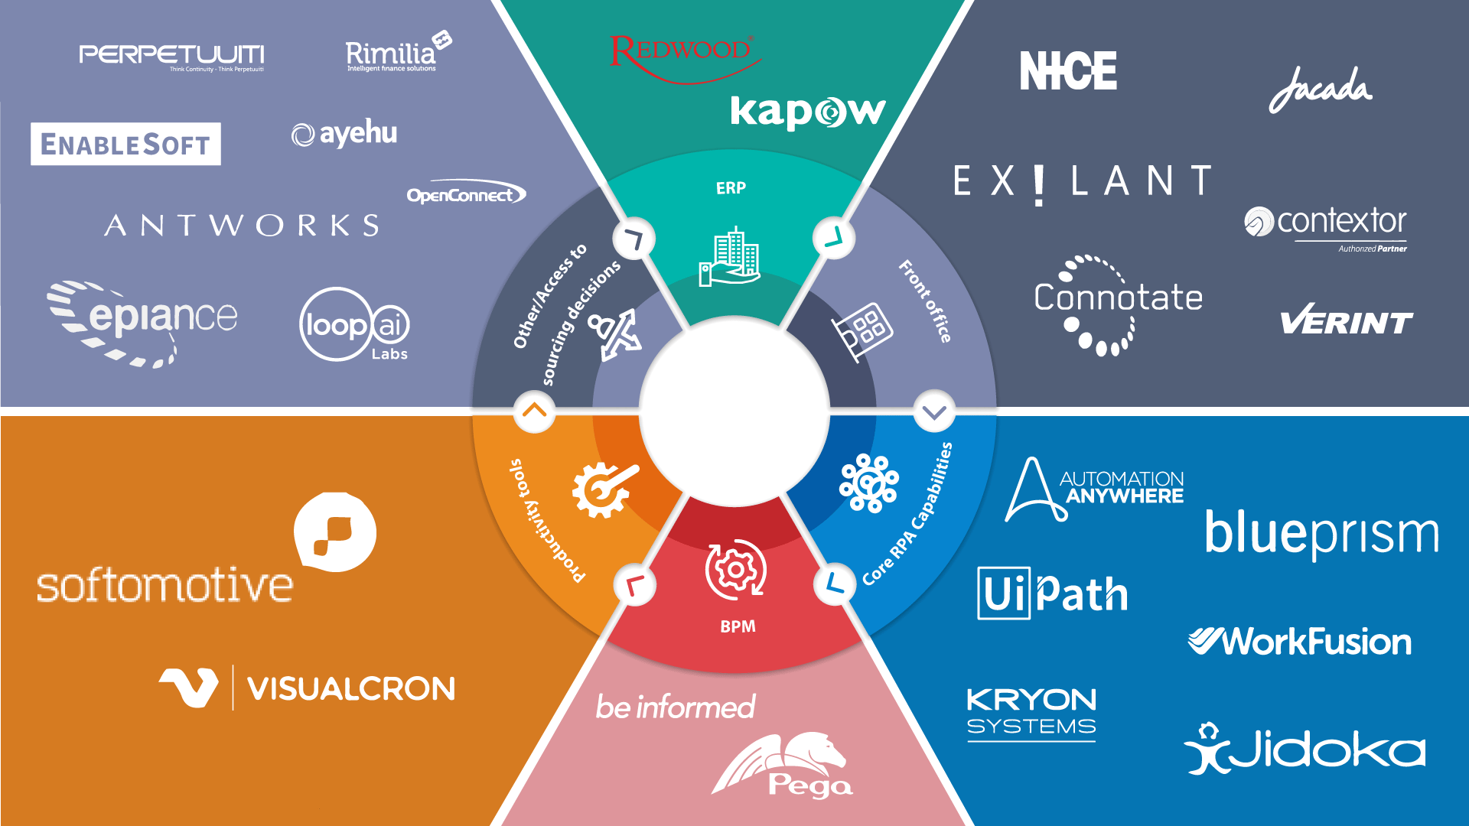
Different tools for RPA?

Slide 7
RPA Tools Comparison
Features | UiPath | Blue Prism | Automation Anywhere
How will I learn? | Has a community edition/ Free edition available | No trial version available | Trial version is available for 30 days
Learning Curve | Has a user-friendly visual designer | Has a user-friendly visual designer, easier than Automation Anywhere | Developers friendly but requires high programming skills
Google Trends Popularity | Most Popular tool | More popular than Automation Anywhere | Least popular tool in the trio

Slide 8
Using UiPath

Slide 9
What is UiPath?
UiPath is a Windows desktop (RPA) Software designed to empower business analysts to automate business processes within their companies.
It works on flow-chart and element activities. It provides change management, deployment management, access control, process modeling, remote execution and scheduling, execution monitoring, auditing and analytic’s in full compliance with enterprise security and governance best practices.
Workflows
Different Panes (Output, Activities, Project, Variables, Arguments etc.)
Types of Activities
Recording
Screen Scraping
Data Scraping
User Events
UiExplorer
Debugging

Slide 10
UiPath UI Demo
Workflows
Different Panes (Output, Activities, Project, Variables, Arguments etc.)
Types of Activities
Recording
Screen Scraping
Data Scraping
User Events
UiExplorer
Debugging

Slide 11
Data Scrapping Demo
Scrapping data from wiki for RPA keyword

Slide 12
Advance Topics (not part of this training)
Orchestrator (advance session)
Dispatcher
Performer
Dashboard
Services=> tanent
Running remotely
Deployment
Orchestrator
Robots
Standard
Floating
Attended
Unattended
Non prod runtime
Jobs, Queues, Logs, Processes, Triggers, Assets, Tasks, Users
Machines
Standard Machine
Machine Template
Packages

